Slide 1
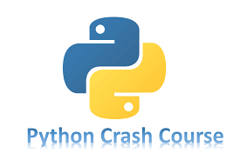

Slide 2
Chapter 4
WORKING WITH LISTS
Brief Summary of Chapter 4
Chapter 4 explains how to work with lists in Python. It shows how to create lists, access items in them, and use the range() function to make lists of numbers. You’ll learn about list comprehensions, which let you create lists in a shorter way, and how to use slices to get parts of a list. The chapter also covers copying lists, so you don’t change the original, and introduces tuples, which are like lists but can’t be changed. Finally, it gives advice on writing clean and readable code.

Slide 3
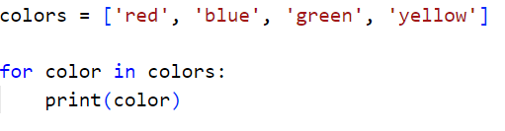
Looping Through an Entire List
When working with lists in Python, often you need to do something with each item in the list, such as printing it, changing it, or performing calculations. To do this, Python provides a for loop, which allows you to go through each item in the list one by one. This process is called iterating through the list. The loop works by assigning each item in the list to a temporary variable during each iteration, so you can access and perform operations on the individual elements.
Example:
The for loop ,loops through the colors list and prints each color one by one. The variable color is temporarily set to each item in the list as the loop runs

Slide 4
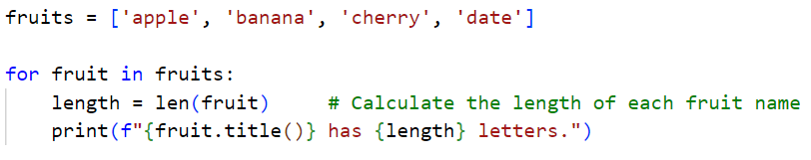
How to Perform Additional Tasks Within a for Loop
The code loops through a list of fruit names, calculates the length of each name, and prints a message showing the fruit and its name length.

Slide 5
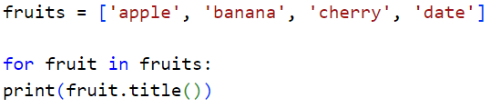
Avoiding Indentation Errors
Indentation is important in Python because it shows which lines of code belong together. For example, the code inside a for loop or a function needs to be indented to indicate that it's part of that loop or function. If the indentation is incorrect, Python will raise an IndentationError. To avoid this, always use consistent indentation (typically four spaces) and avoid mixing tabs and spaces.
Forgetting to Indent:
The print(fruit.title()) line is not indented, so Python doesn’t know it should be part of the for loop. This causes an IndentationError.

Slide 6

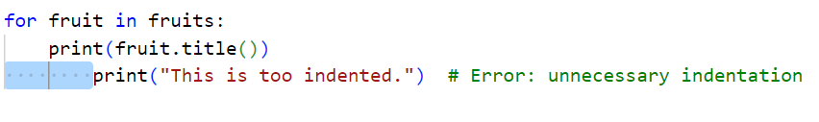
Forgetting the Colon:
If you forget the colon at the end of the loop or if statement, Python will raise a SyntaxError.
Indenting Unnecessarily:
If you indent lines too much or in the wrong places, it can cause unexpected behavior.

Slide 7
Making Numerical Lists
Making numerical lists in Python involves using lists to store sets of numbers for various purposes, such as tracking game positions or creating data visualizations. One of the most useful tools for this is the range() function, which generates a series of numbers, often used with list() to create a list of numbers. Additionally, you can control the step size in the range() function to skip numbers or generate specific patterns.
To perform simple calculations like squares or other transformations, loops can be used, with or without temporary variables. For conciseness, list comprehensions allow you to generate lists in a single line of code by combining a for loop with an expression. Python also provides built-in functions like min(), max(), and sum() for performing simple statistics on lists of numbers, making it easier to work with large datasets.

Slide 8
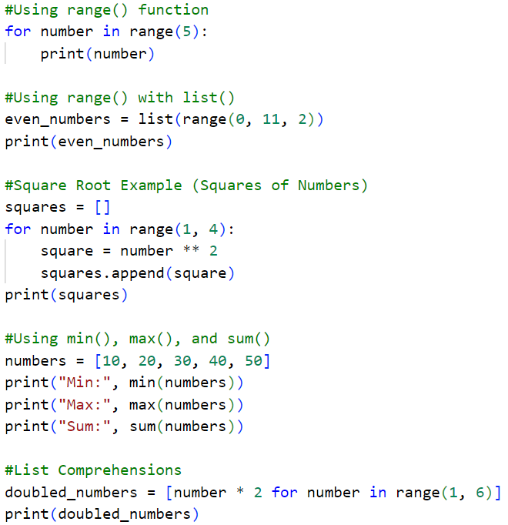

Slide 9
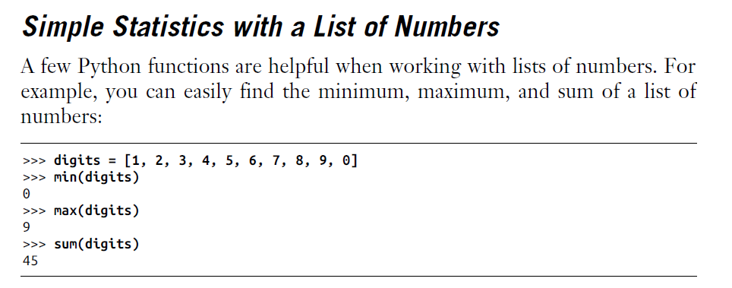

Slide 10
Working with Part of a List
Working with part of a list in Python is done using a slice. Slicing allows you to select a specific section of a list by providing a range of positions. You can specify where to start and where to stop, and Python will return the part of the list within this range. For example, if you want the first three items, you slice from the beginning up to index 3, but it won’t include the item at index 3.
You can also omit the start or end index to get the beginning or end of the list. Using a negative index counts from the end of the list. Slicing is useful when you need to work with part of a list, such as showing a section of data or handling specific items. You can loop through slices of a list to process each item. Slicing can also create a copy of a list, so you can work with a separate version without affecting the original.

Slide 11
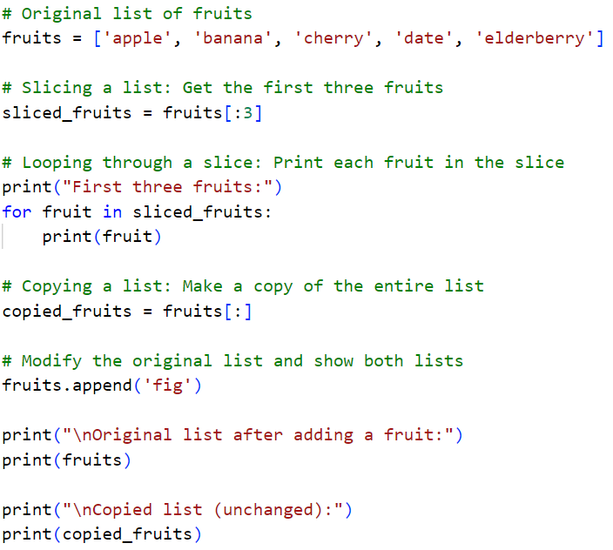
Slicing a List: The list sliced_fruits contains the first three items from the original list fruits.
Looping Through a Slice: The for loop goes through the sliced_fruits and prints each one.
Copying a List: The list copied_fruits is a copy of the original list fruits. When we add a new item to fruits, it doesn't affect copied_fruits.

Slide 12
Tuples
Tuples in Python are collections of items that cannot be changed once they are created. They are defined using parentheses () instead of square brackets like lists. Tuples are useful when you need to store data that should stay the same throughout the program. You can access items in a tuple using an index and loop through them, just like lists. Although you can't change the items inside a tuple, you can assign a new tuple to the same variable. Tuples are helpful when you want to protect your data from accidental changes.

Slide 13
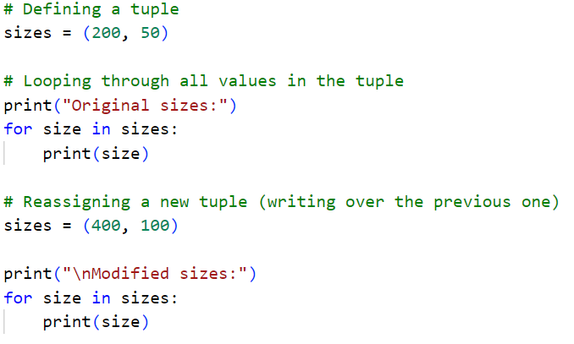

Slide 14
Styling Your Code
When writing longer programs, it's important to style your code for better readability. Python programmers follow common styling rules to keep code consistent and easier to maintain.
PEP 8 is the guide that explains how to style Python code. It includes rules like using four spaces for indentation, keeping lines under 80 characters, and using blank lines to separate sections. For more details, you can read the full PEP 8 guide https://peps.python.org/pep-0008/.

Slide 15
Practice Exercises
Do the following TRY IT YOURSELF on pages:
56
60
65
67
70

Slide 16

End
Of
Chapter 4

